Slide 1






TRIPMATE
SMART TRAVEL AND CARPOOL MANAGEMENT
TEAM: TECH TITANS

Slide 2







TABLE
OF CONTENT
Introduction
Objective
Overview
Features
Technologies Overview
Application photo
Conclusion

Slide 3


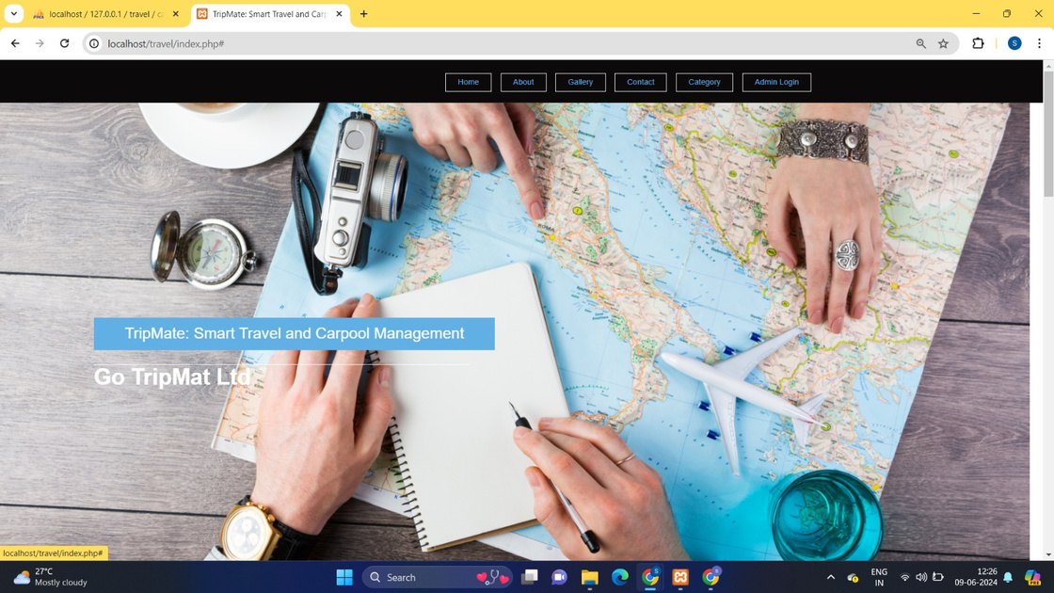

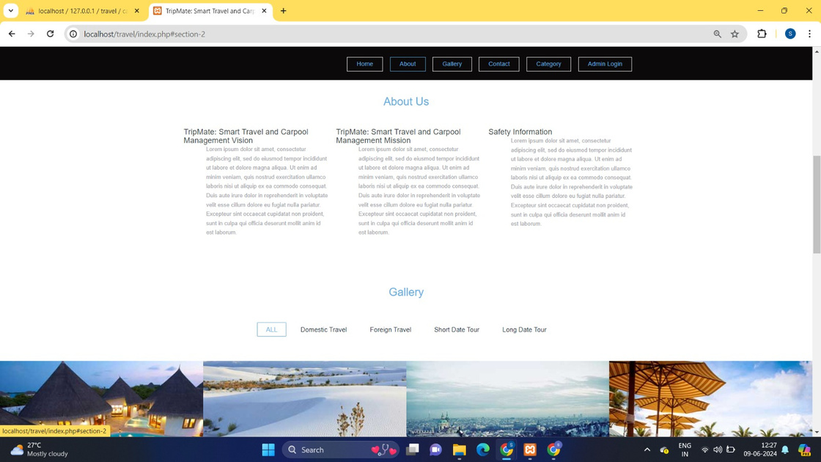

INTRODUCTION
TripMate, developed by Tech Titans, revolutionizes travel planning and carpool management with its innovative web application. It offers a range of features to simplify the travel planning process for users and provides efficient management tools for administrators.

Slide 4

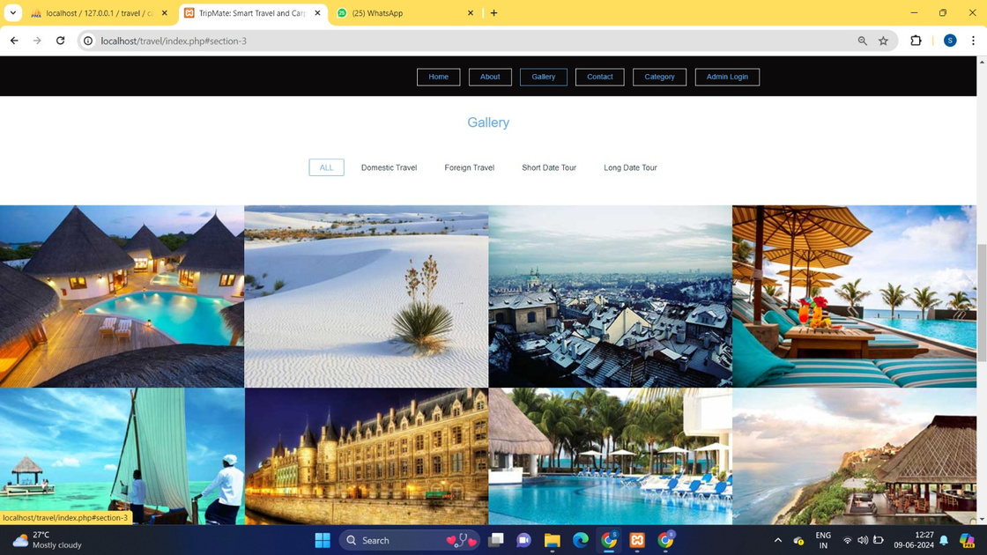

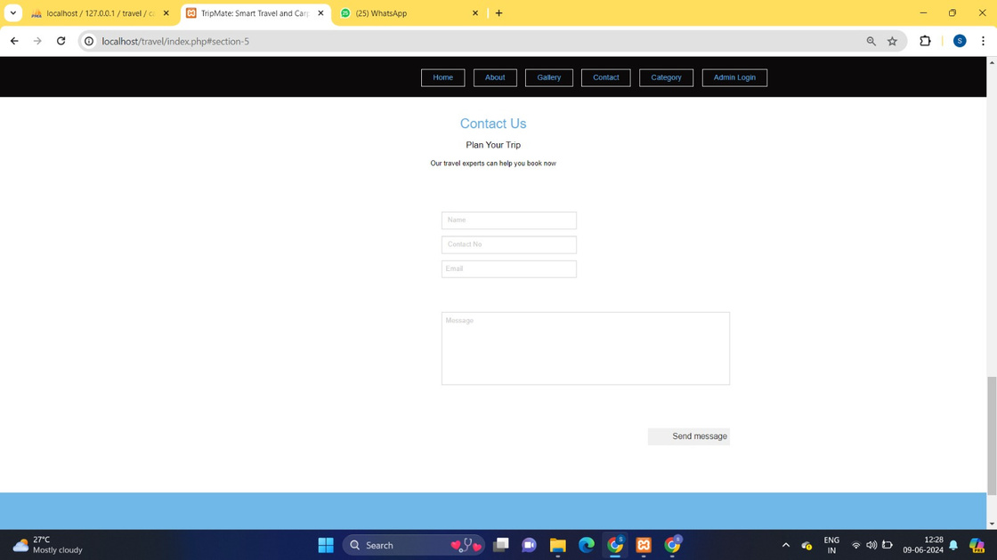

OBJECTIVE
To simplify travel planning for users and provide administrators with efficient management tools. TripMate aims to streamline the process of organizing travel and carpooling, enhancing convenience and reducing administrative burdens.

Slide 5
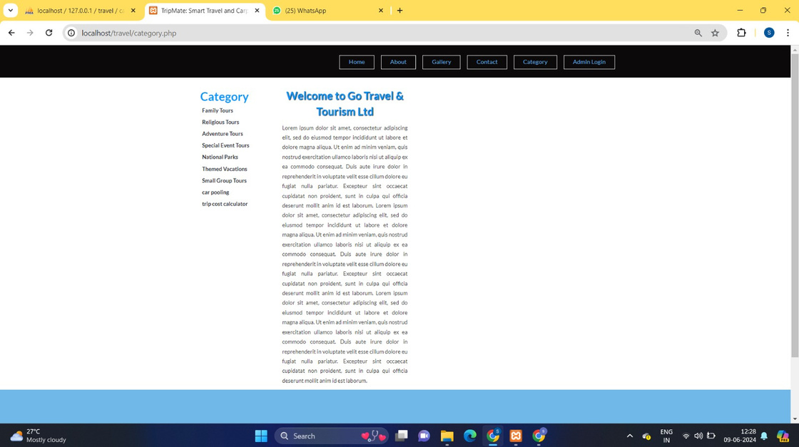

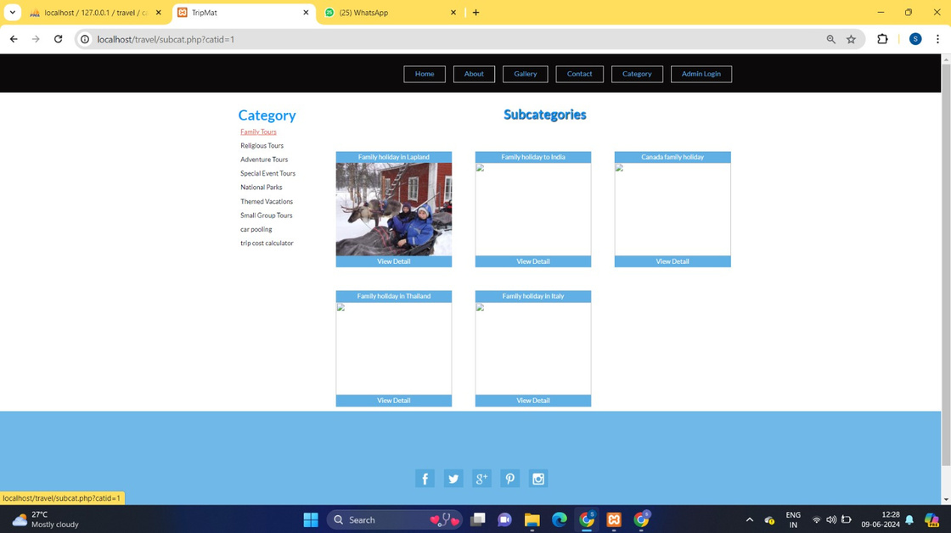

OVERVIEW
TripMate is an innovative web application designed to streamline travel and carpool management. It offers a range of features aimed at simplifying the travel planning process for users and providing efficient management tools for administrators. The key features include online package enquiries, categorized travel packages, an admin panel for user and content management, carpooling options, and a trip cost estimator.

Slide 6


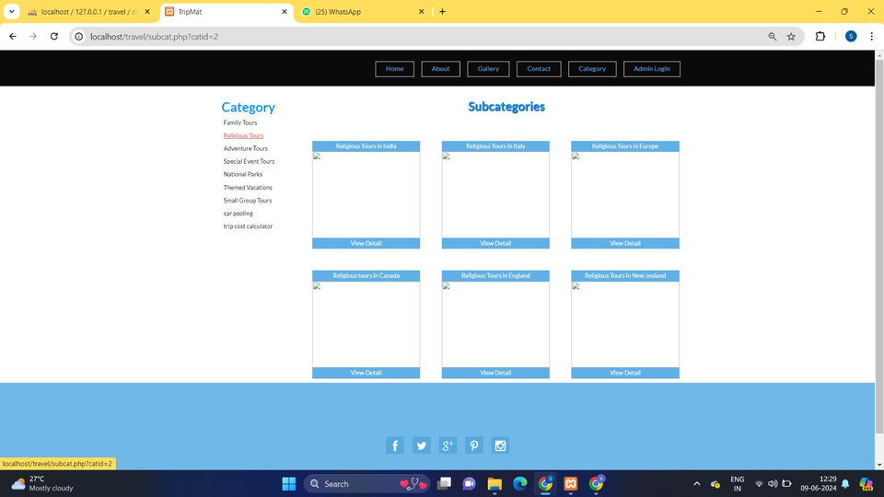
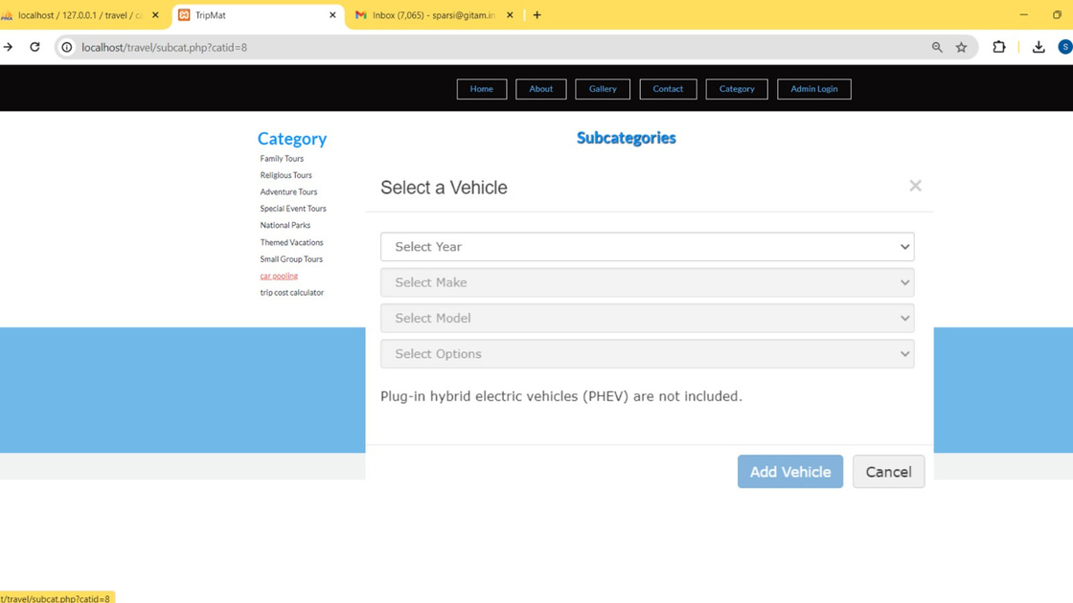
FEATURES
Online Package Enquiry
Users can easily inquire about various travel packages available on the platform. The system provides a user-friendly interface to submit enquiries and receive responses.
Subcategories for Packages
Travel packages are organized into subcategories for better navigation and user experience. This categorization helps users find suitable packages based on their preferences.

Slide 7
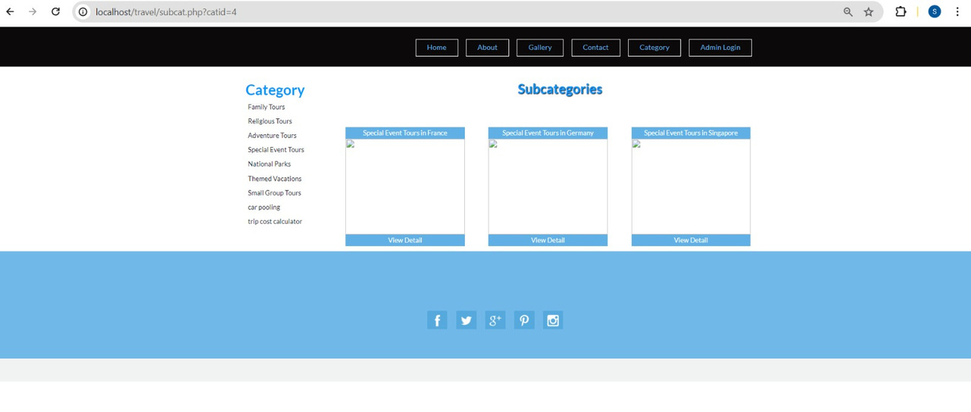
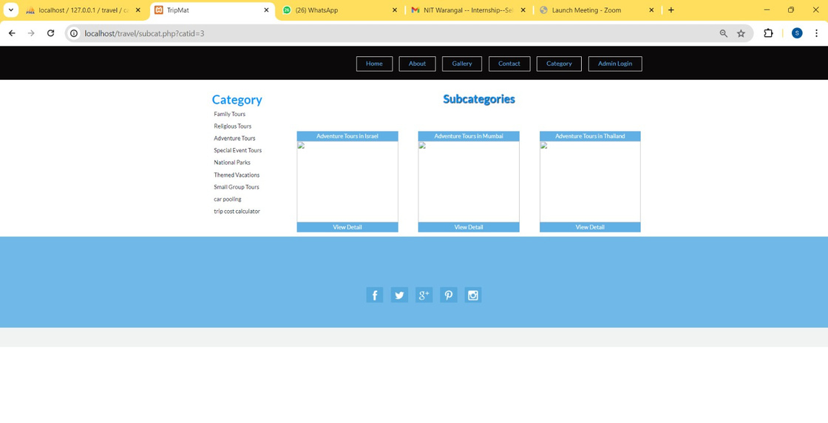
FEATURES
Admin Panel
The admin panel is a powerful tool for managing the platform. Administrators can add, update, or delete users, categories, subcategories, and packages. They can also view and respond to user enquiries.
Carpooling
The carpooling feature allows users to find and join carpool groups, promoting cost-effective and environmentally friendly travel options.
Trip Cost Estimator
This tool provides users with an estimate of the cost for their planned trips, helping them budget effectively.

Slide 8



TECHNOLOGY
OVERVIEW
Front End: HTML, CSS, JavaScript
HTML (HyperText Markup Language):
Used to create web documents, structuring content and layout.
Forms the backbone of TripMate, facilitating webpage creation.
CSS (Cascading Style Sheets):
Creates attractive layouts, enhances visual appeal.
Ensures consistent styling across TripMate for a pleasant user experience.
Bootstrap:
Framework for responsive, mobile-friendly designs.
Ensures accessibility and functionality on various devices.
JavaScript:
Adds interactivity and dynamic elements to web pages.
Enhances user engagement in TripMate.

Slide 9

TECHNOLOGY
OVERVIEW
Back End: PHP, MySQL
PHP:
Server-side scripting language for dynamic web pages.
Handles server-side logic, interacts with databases.
Enables robust web application development in TripMate.
MySQL:
Relational database management system.
Stores and manages data in TripMate.
Provides efficient querying and management capabilities.
Github Link

Slide 10
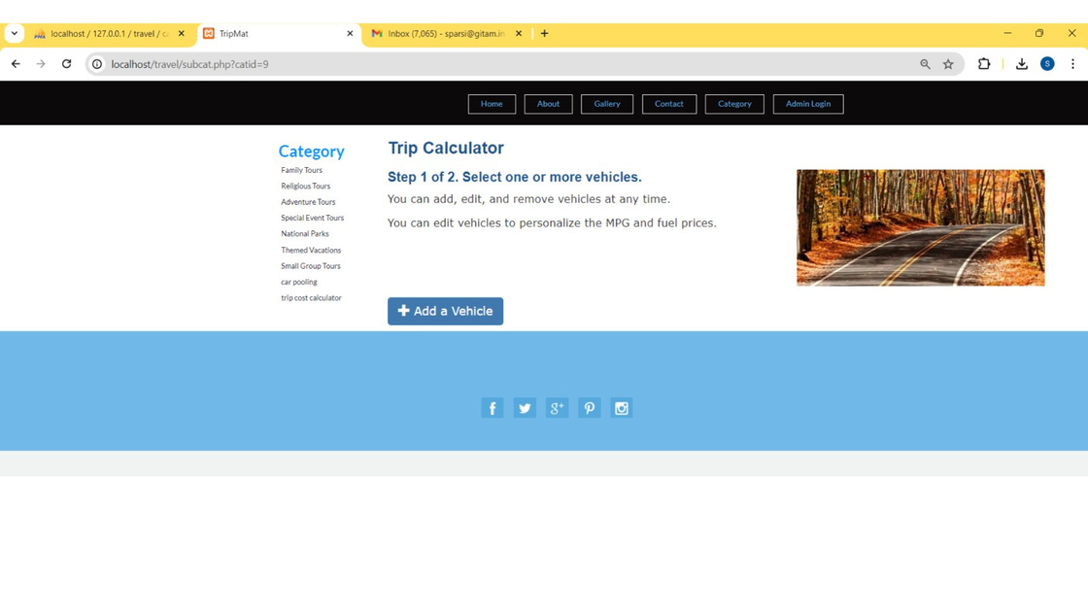
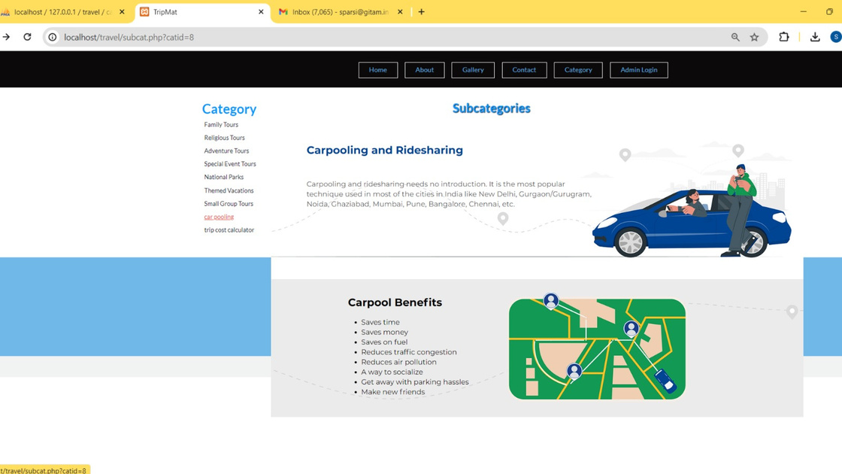
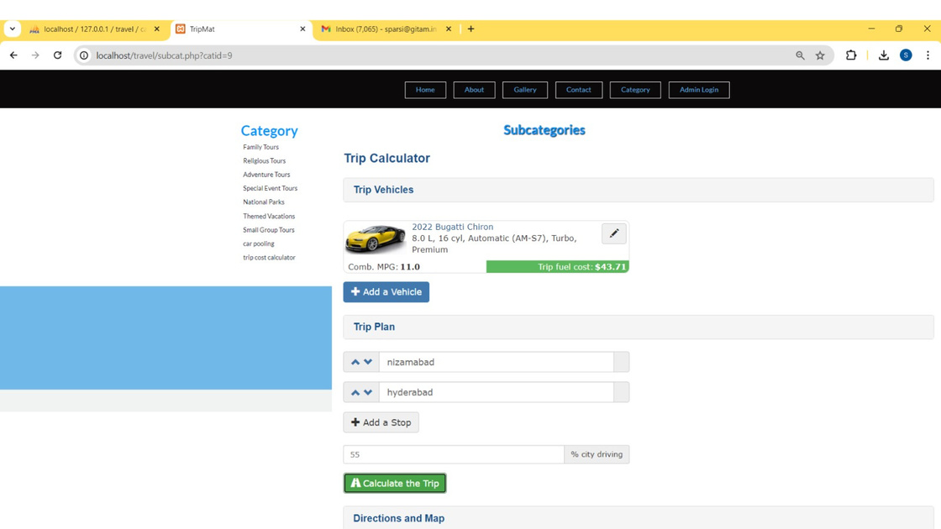
APPLICATION PHOTO

Slide 11
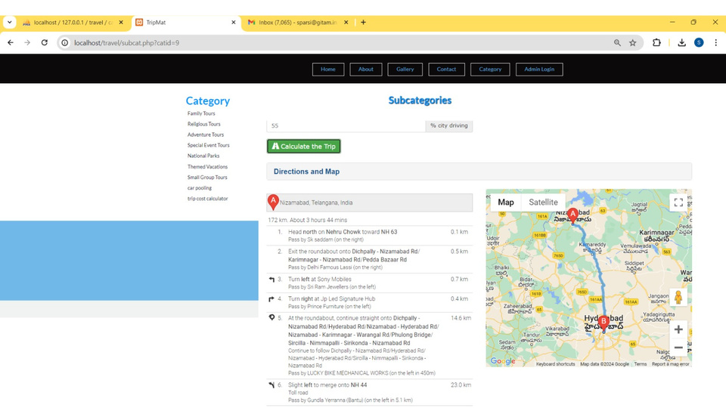
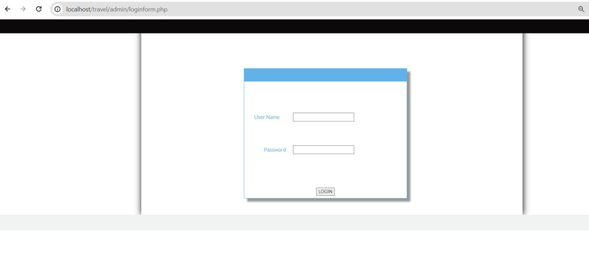
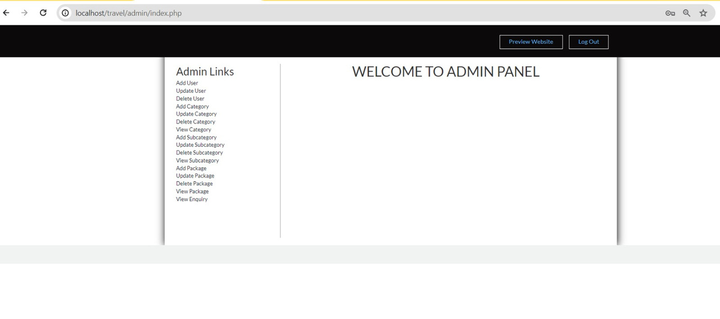
APPLICATION PHOTO

Slide 12


Conclusion
TripMate, developed by the Tech Titans team, is a comprehensive solution for modern travel and carpool management. By leveraging front-end technologies like HTML, CSS, JavaScript, and Bootstrap, and back-end technologies like PHP and MySQL, TripMate offers a robust and user-friendly platform. It addresses the needs of travelers and administrators alike, providing efficient tools for package enquiries, carpooling, and trip cost estimation. With its innovative features and intuitive design, TripMate is set to transform the way people plan and manage their travel experiences.
Q&A?

Slide 13


THANK
YOU
Team, Tech Titans
Sampreeth parsi - HU21CSEN0101411
Moksha Sai K - HU21CSEN0101291
Karthik Pagidi - HU21CSEN0100708
Manikantha K - HU21EECE0100311
Yashaswi Rekha - HU21CSEN0101262

